Slide 1




STEREO AUDIO AMPLIFIER
PROJECT PRESENTATION

Slide 2
STEPS FOR IMPLEMENTATION
01
02
03
04
SEARCHING
SIMULATION & TESTING
PCB MANUFACTURE
PACKAGING
05
RESULTS

Slide 3



01
SEARCHING

Slide 4
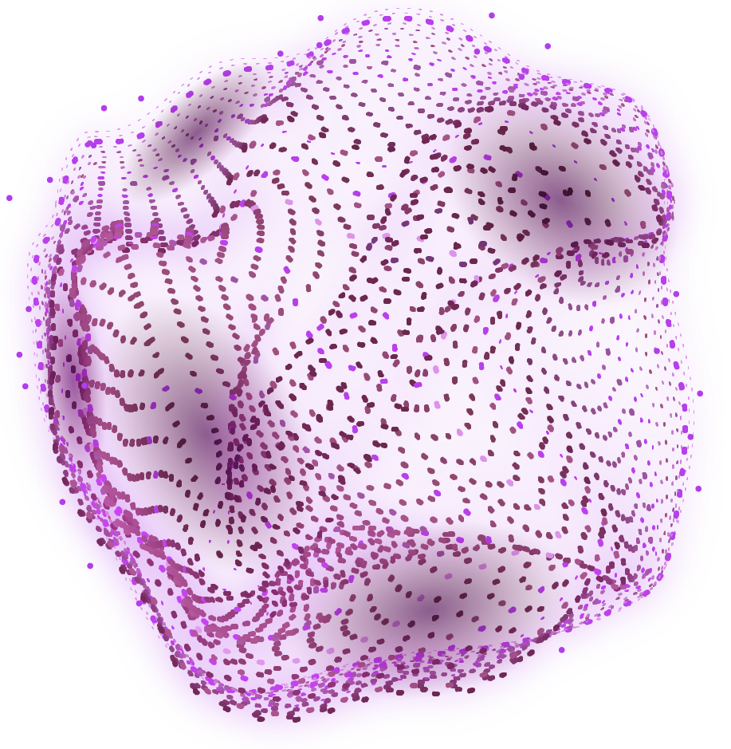
1-Searching about the stereo audio amplifier , How it works and What is the difference between mono and stereo audio amplifier .
2-Searching for the required components and the available ones .
3-Searching for the data sheets for the selected components like lm386 datasheet , studying the component maximum ratings , Electrical Characteristics and Operating Conditions to make sure that the selected component will meet the required requirements .
4-Searching and looking for the best circuit that can achieve our requirements.

Slide 5

02
SIMULATION & TESTING

Slide 6
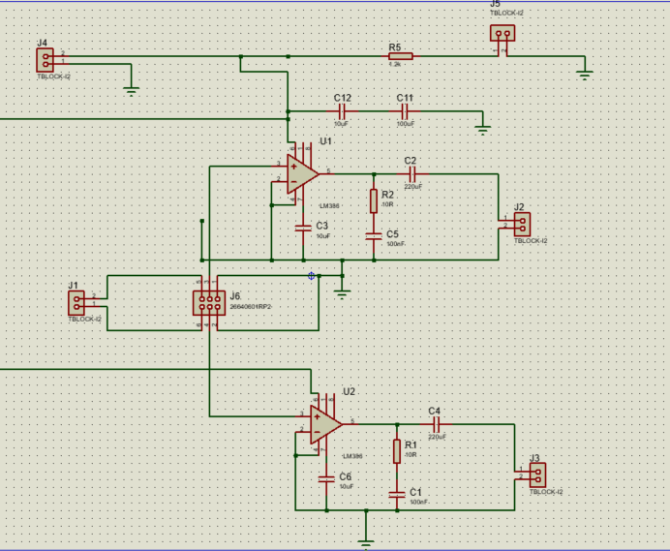
We start with simulating the selected circuit on the simulation software

Slide 7
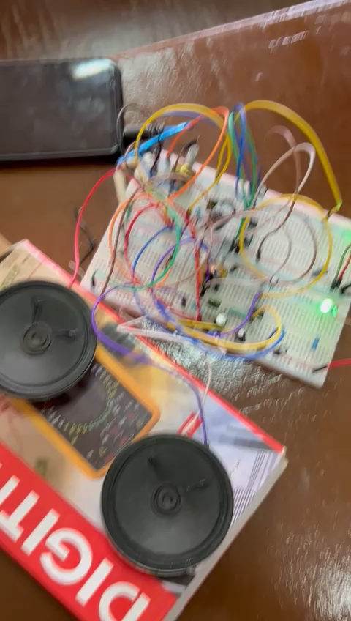
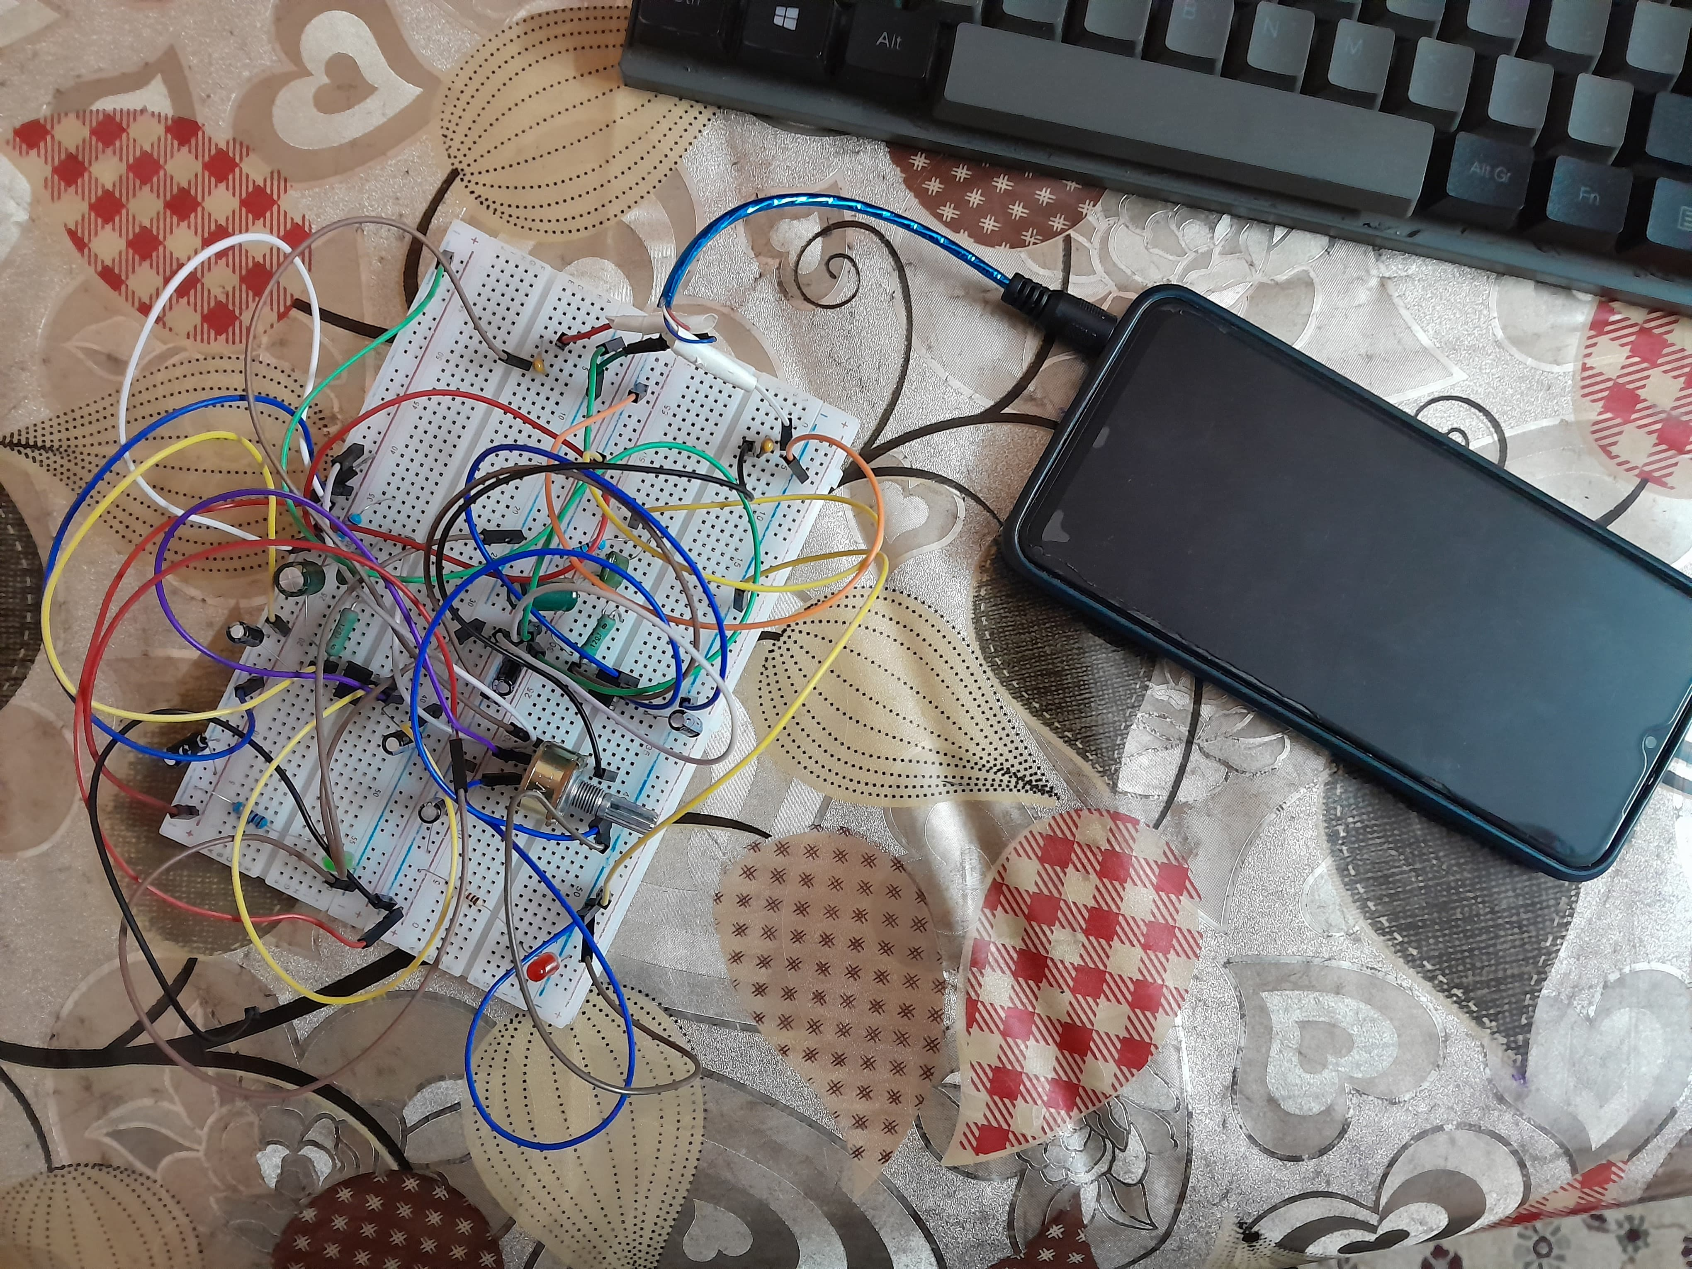
We tried to improve the output and tried to stop any distortion on the output . After having the best possible sound quality we started applying on the test board and this was the result.

Slide 8

03
PCB MANUFACTURE

Slide 9
PCB step had to be the most accurate step to avoid any mistake in the board that may force us to make it again , and we succeeded in that
Putting the ink on the board by an iron
Remove the ink that is on the copper paths
Using the Etching solution to remove the not useful copper
Check if there is any broken path.
Solder the
components on the board
Drill the board

Slide 10

04
PACKAGING

Slide 11
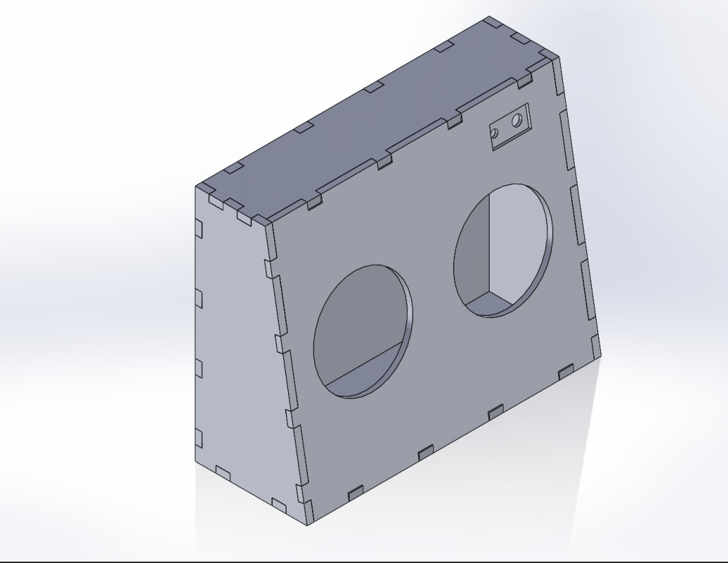
PACKAGING PROCESS
1- DESIGN
The packaging design is created, taking into account factors such as product size, shape, and branding requirements.

Slide 12
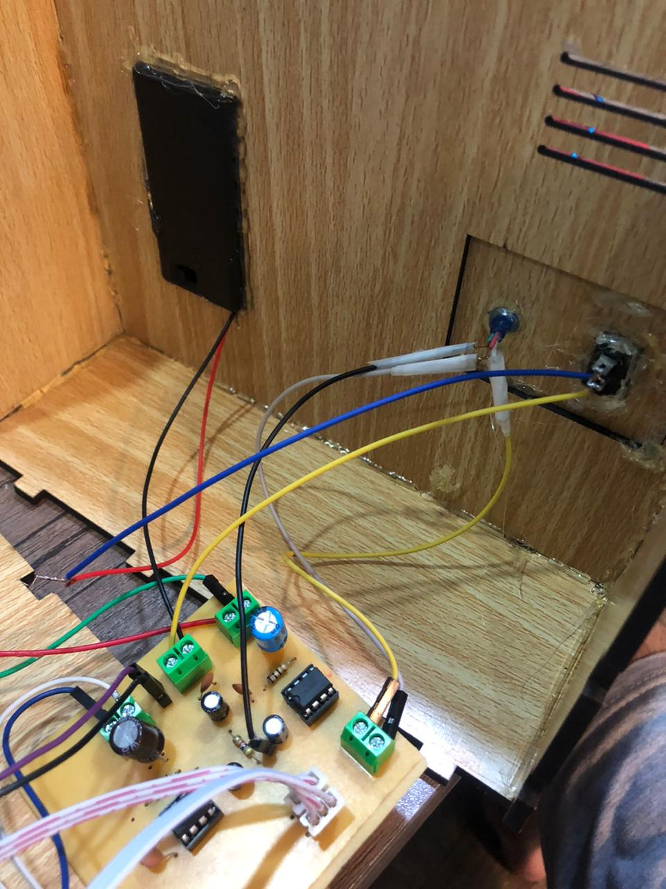
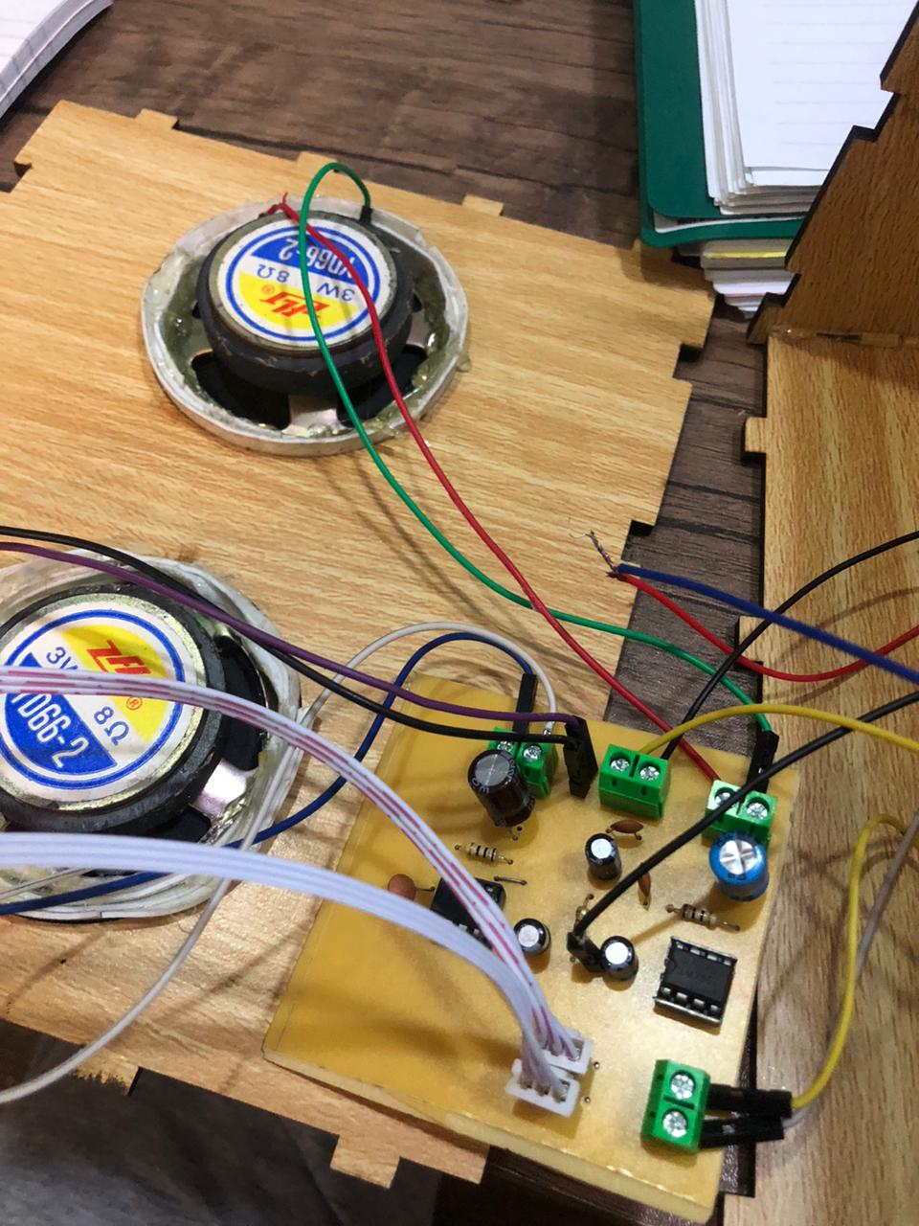
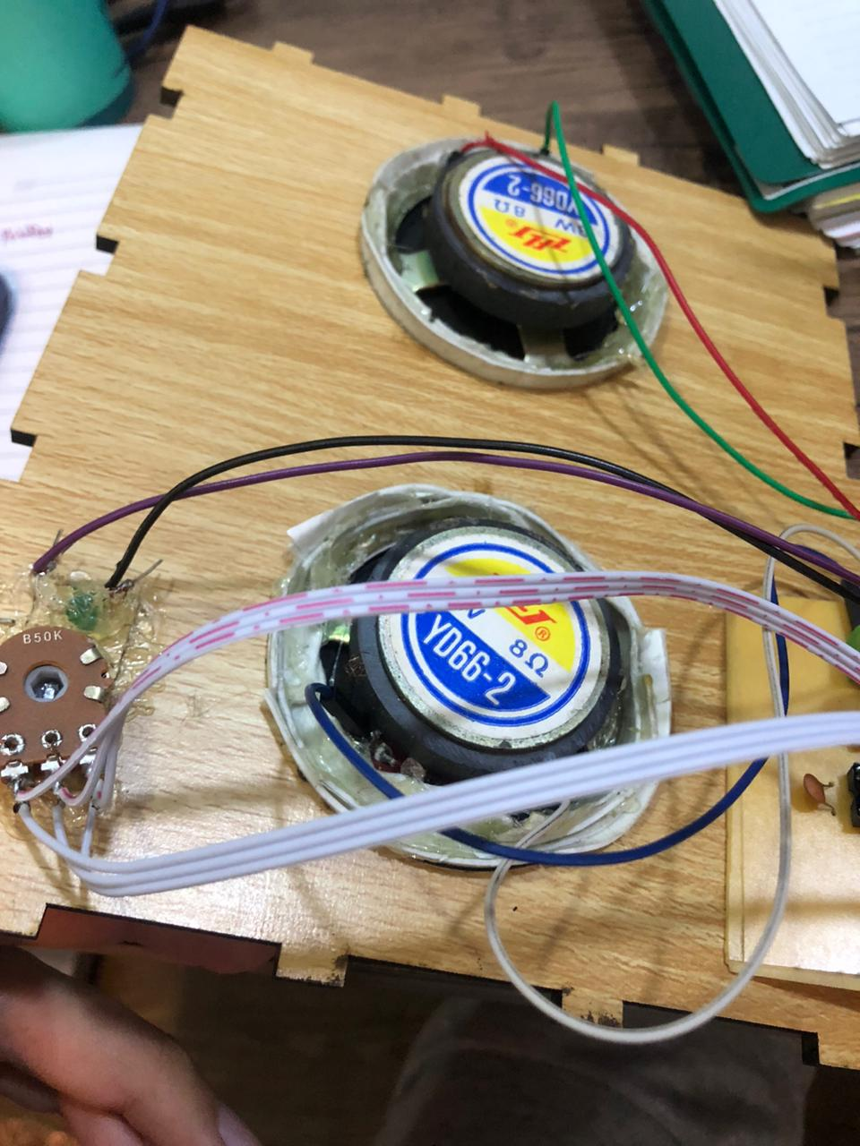
PACKAGING PROCESS
2- MATERIAL SELECTION
The appropriate packaging materials are chosen based on the nature of the product, its fragility, shelf life requirements, and any regulatory considerations.
3- FILLING
The product is filled into the selected packaging, either
manually or using automated filling machines. This step
ensures that the correct amount of product is placed in
each package.

Slide 13
05
RESULTS

Slide 14
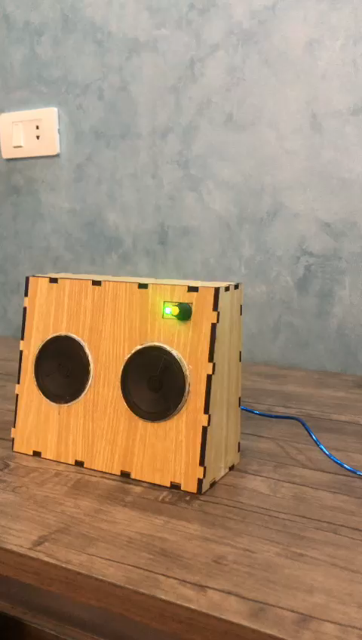
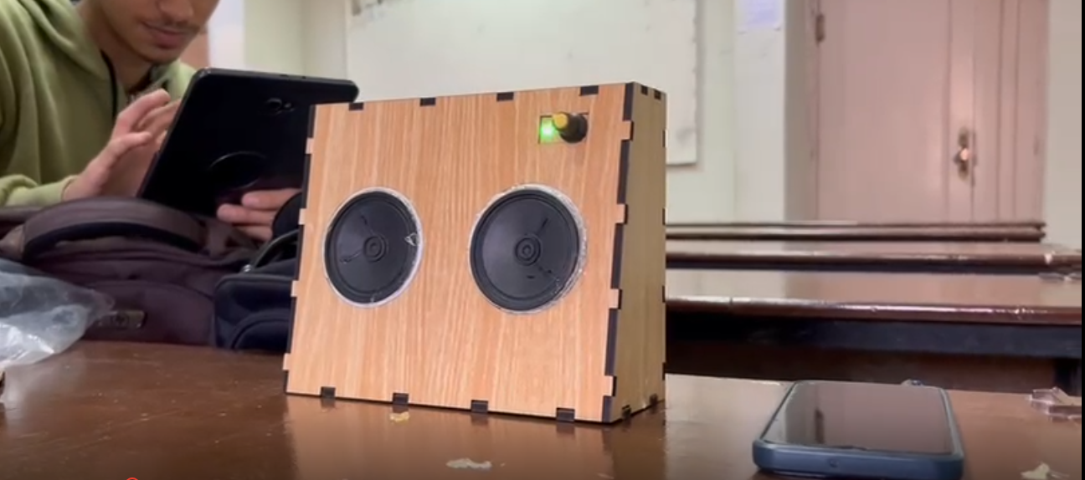
Here is the final look for the project

Slide 15
THANKS
Supervised by Dr Saeed Emam
Group 5 members :
- Ziad Belal
- Ashraf Abo Bakr
- Hassan Sayed
- Ziad Mohamed
- Ahmad Sakr

